Slide 1


CITY ENGINEERING COLLEGE
DEPARTMENT OF COMPUTER SCIENCE AND ENGINEERING
INTERNSHIP PRESENTATION
ON
“TEMPERATURE MONITORING ANDROID APP WITH GLOBAL REAL TIME DATA ACCESSIBILITY USING IoT”
Under the guidance of:
Mrs. DEEPIKA R
By:
KRUPA D
1CE17CS052

Slide 2
abstract
“TEMPERATURE MONITORING ANDROID APP WITH GLOBAL REAL TIME DATA ACCESSIBILITY USING IoT” is a Project which aims in Developing an Android Application which is built using MIT App Inventor, a real time database which is built using Firebase, Node MCU, Temperature Sensor and IoT Hardware Components. This system can be made use in many domains such as Digital temperature monitoring in laboratories, Food safety Compliances, Warehouse and Inventory Management, Monitoring of different Equipment and many more domains as such.
This System mainly aims in Global data Accessibility which can be achieved by using Globally accessible Real time Database that is Firebase and the Temperature data is then retrieved using an Android Application using MIT Android Application Inventor. And an IoT system that is designed to collect data from surroundings and send it to the Real time Database.

Slide 3
introduction
IoT and Embedded System
The Internet of Things (IoT) refers to the ever growing network of technologies connecting and communicating via the internet to send and receive data in the absence of human-to-human or human-to-computer interaction. IoT consists of a network of smart devices, sensors, and actuators interconnecting with each other over the internet.
Cisco Packet Tracer
Packet Tracer is a cross-platform visual simulation tool designed by Cisco Systems that allows users to create network topologies and imitate modern computer networks. The software allows users to simulate the configuration of Cisco routers and switches using a simulated command line interface. Packet Tracer makes use of a drag and drop user interface, allowing users to add and remove simulated network devices as they see fit. Packet Tracer can also be run on Linux, Microsoft Windows, and macOS. Similar Android and iOS apps are also available.
IoT Hardware Components
Sensors – gather information about the environment and condition signals before transmitting to the microprocessor.
Microcontrollers – process the signal from sensors, determine appropriate responses, manage power consumption and local memory.
Communication – wireless chips, radio modules and protocols needed to transmit the information between devices and to the cloud.

Slide 4
Arduino and Arduino Programming
Arduino is an open-source electronics platform based on easy-to-use hardware and software. Arduino boards are able to read inputs - light on a sensor, a finger on a button, or a Twitter message - and turn it into an output - activating a motor, turning on an LED, publishing something online. You can tell your board what to do by sending a set of instructions to the microcontroller on the board. To do so you use the Arduino programming language (based on Wiring), and the Arduino Software (IDE), based on Processing.
Firebase
The Firebase Realtime Database lets you build rich, collaborative applications by allowing secure access to the database directly from client-side code. Data is persisted locally, and even while offline, realtime events continue to fire, giving the end user a responsive experience.
MIT App Inventor
MIT App Inventor is a web application integrated development environment originally provided by Google, and now maintained by the Massachusetts Institute of Technology (MIT). It allows newcomers to computer programming to create application software(apps) for two operating systems (OS): Android, and iOS

Slide 5
Company Profile
The Company is involved in IoT and Embedded Systems based Services. Current Status of SST TECHNOLOGIES is – Active.
Product Sales & Distribution – provides personalized sales and distribution related Services, Creating experiences and Guiding Customers for better spend.
Technical Support & Services – provides extended support to the business for smooth functioning of their IT infrastructure through customized Engineering outsourcing services.
SST Technologies, is a leading provider of IoT and Embedded System Technologies and related Services. They are known for our Industry Knowledge, worker’s quality, compliance, customer-centric approach and flexibility, and Today, SST Technologies has evolved as a premier provider of manpower for their Junior/middle & Amp; executive talent management Staffing needs.
Vision : We believe that SST Technologies is the platform for all Engineering Graduates, where we transform their knowledge into SKILLS, where we bridge the gap between classrooms to work stations and where our clients meet their Expectations.
Mission : @ SST Technologies, build the best IoT and Embedded System based professionals for IT industry. We have reinvented the ways of Technical Hiring and On Job Training for the aspiring engineers towards reshaping them into stronger a team player.

Slide 6
About The Company
Recognize the importance of implementing the right solution for your Domain. We offer a wide range of services to build a solution that is right for your Domain.
Every Domain, no matter the size, needs advice and support. We have several years of Technical Experience and have accumulated a wealth of IT Infrastructure knowledge. Our Services helps you to establish your requirements. We will be with you every step of the way, from product selection through to configuration and Installation.
To stay Relavent to our Customers, it is important that we continuously demonstrates our ‘Value Creating Ability’ by :
Helping our Customers to choose the right Hardware.
Bring competitive commercials to the discussion table.
Remaining predictable in our execution.
Backing it with excellent post-sales services.
Since established in 2018, SST Technologies has become a pioneer in providing distinguished end-to-end IT Infrastructure solutions to its customers through our business functions maximizing customer engagement with personalized services. We believe that today more than ever, business are dependent on technology solutions.

Slide 7
Training content
“TEMPERATURE MONITORING ANDROID APP WITH GLOBAL REAL TIME DATA ACCESSIBILITY USING IOT” is an IoT based System, which provides users to monitor temperature from any part of the world. Users can directly download the APK file available or QR code available to download the Android Mobile Application and start retrieving the Real time data on the Smartphone.
1. IoT – Internet Of Things
Internet of Things (IoT) is a network of physical objects or people called "things" that are embedded with software, electronics, network, and sensors that allows these objects to collect and exchange data. The goal of IoT is to extend to internet connectivity from standard devices like computer, mobile, tablet to relatively dumb devices like a toaster. IoT makes virtually everything "smart," by improving aspects of our life with the power of data collection, AI algorithm, and networks

Slide 8
Working :
1) Sensors/Devices: Sensors or devices are a key component that helps you to collect live data from the surrounding environment. All this data may have various levels of complexities. It could be a simple temperature monitoring sensor, or it may be in the form of the video feed.
2) Connectivity: All the collected data is sent to a cloud infrastructure. The sensors should be connected to the cloud using various mediums of communications. These communication mediums include mobile or satellite networks, Bluetooth, WI-FI, WAN, etc.
3) Data Processing: Once that data is collected, and it gets to the cloud, the software performs processing on the gathered data. This process can be just checking the temperature, reading on devices like AC or heaters. However, it can sometimes also be very complex like identifying objects, using computer vision on video.
4)User Interface: The information needs to be available to the end-user in some way which can be achieved by triggering alarms on their phones or sending them notification through email or text message. The user sometimes might need an interface which actively checks their IoT system.

Slide 9
2. Embedded Systems
An Embedded System is a system that has software embedded into computer-hardware, which makes a system dedicated for a variety of application or specific part of an application or product or part of a larger system.An embedded system can be a small independent system or a large combinational system. It is a microcontroller-based control system used to perform a specific task of operation. An embedded system is a combination of three major components:
Hardware: Hardware is physically used component that is physically connected with an embedded system. It comprises of microcontroller based integrated circuit, power supply, LCD display etc.
Application software: Application software allows the user to perform varieties of application to be run on an embedded system by changing the code installed in an embedded system.
Real Time Operating system (RTOS): RTOS supervises the way an embedded system work. It act as an interface between hardware and application software which supervises the application software and provide mechanism to let the processor run on the basis of scheduling for controlling the effect of latencies.

Slide 10
3.Cisco Packet Tracer
Cisco Packet Tracer is: “a powerful network simulation program that allows students to experiment with network behaviour and ask “what if” questions.”
It further says: “The simulation-based learning environment helps students develop 21st century skills such as decision making, creative and critical thinking, and problem solving. Packet Tracer complements the Networking Academy curricula, allowing instructors to easily teach and demonstrate complex technical concepts and networking systems design.”
Nothing could have defined that better. The biggest problem in learning networking is the need for multiple devices that from a network. Cisco Packet Tracer removes that hurdle altogether and that too simply. Although there are other network simulation programs (say GNS3), they need device images. Packet tracer has them inbuilt.
This software is available for free from Cisco’s website provided you are a registered Networking Academy student, alumni, instructor, or administrator.

Slide 11
4. IoT Hardware Components
The set of devices that respond and have the capabilities to capture data, follow the instructions can be considered as the IoT Hardware. The following fall into such categories where they not only collect data but also respond to instructions based on the processed data.
Chips : This is much a broader classification that contains all the electrical and electronic appliances such as microcontrollers, chips, integrated circuits, radio frequency systems, etc.
Sensors : Sensors, which are one of the base components of an IoT system, have three modules to it - Power Management modules, Sensing modules, and the Energy modules.
Actuators : These devices provide the motion to a data collection system such as the solenoids, comb drives etc to fetch details based on movements.
Standard devices : Standard devices constitute of the generally used devices such as Tablets, Smartphones, Switches, Routers and etc. Each of these devices have their own set of settings that allow them to collect data.

Slide 12
5 Arduino Programming
Arduino programs are written in the Arduino Integrated Development Environment (IDE). Arduino IDE is a special software running on your system that allows you to write sketches for different Arduino boards. The Arduino programming language is based on a very simple hardware programming language called processing, which is similar to the C language. After the sketch is written in the Arduino IDE, it should be uploaded on the Arduino board for execution.
6 Firebase
Firebase is a backend platform for building Web, Android and IOS applications. It offers real time database, different APIs, multiple authentication types and hosting platform.

Slide 13
Steps To Create Firebase Account :
Navigate to https://firebase.google.com/ and sign in in the top right hand of the page.
After creating an account and signing in, create a project by clicking the "Add Project" button.
Fill out the highlighted fields in the window that pops up. Name your project anything you want. Click the "Create Project" button.
Once the project has been created, you'll be taken to the page below to configure various settings to enable push notifications in your white label apps for Android and iOS.
7 MIT App Inventor
MIT App Inventor is a free, cloud-based service that allows you to make your own mobile apps using a blocks based programming language. You access App Inventor using a web browser (Chrome, Firefox, Safari).

Slide 14
Steps To Create MIT App Inventor :
Step 1a : From the User Interface palette, drag and drop the Button component to Screen1 .
Step 1b : To give the button the image of the bee, in the Properties pane, under Image, click on the text "None..." and click "Upload File..." . A window will pop up to let you choose the image file. Click "Browse" and then navigate to the location of the codi.jpg file you downloaded earlier . Click the codi.jpg file, click "Open", and then click "OK".
Step2 : ChangetheButton's Text property : Delete "Text for Button1", leaving the Button's text property blank so that there is no writing over the bee image.
Step3 : From the User Interface palette, drag and drop the Label component to the Viewer, placing it below the picture of the bee. It will appear under your list of components as Label1.
Under the Properties pane, change the
Text property of Label1 to read "Touch the Bee". You'll see the text change in the Designer and on your device.
FontSize to 30.
BackgroundColor of Label1 by clicking on the box.
TextColor to any color you like.

Slide 15
Step 4. Under Palette, click on the Media drawer and drag out a Sound component and place it in the Viewer. Wherever you drop it, it will appear in the area at the bottom of the Viewer marked Non-visible components. Under the Media pane, Click Upload File. Browse to the location of the mp3 file that you downloaded earlier and upload it to this project. Under the Properties pane, see that the Source property currently says None.... Click the word None... to change the Sound1 component's Source to Bee-Sound.mp3.

Slide 16
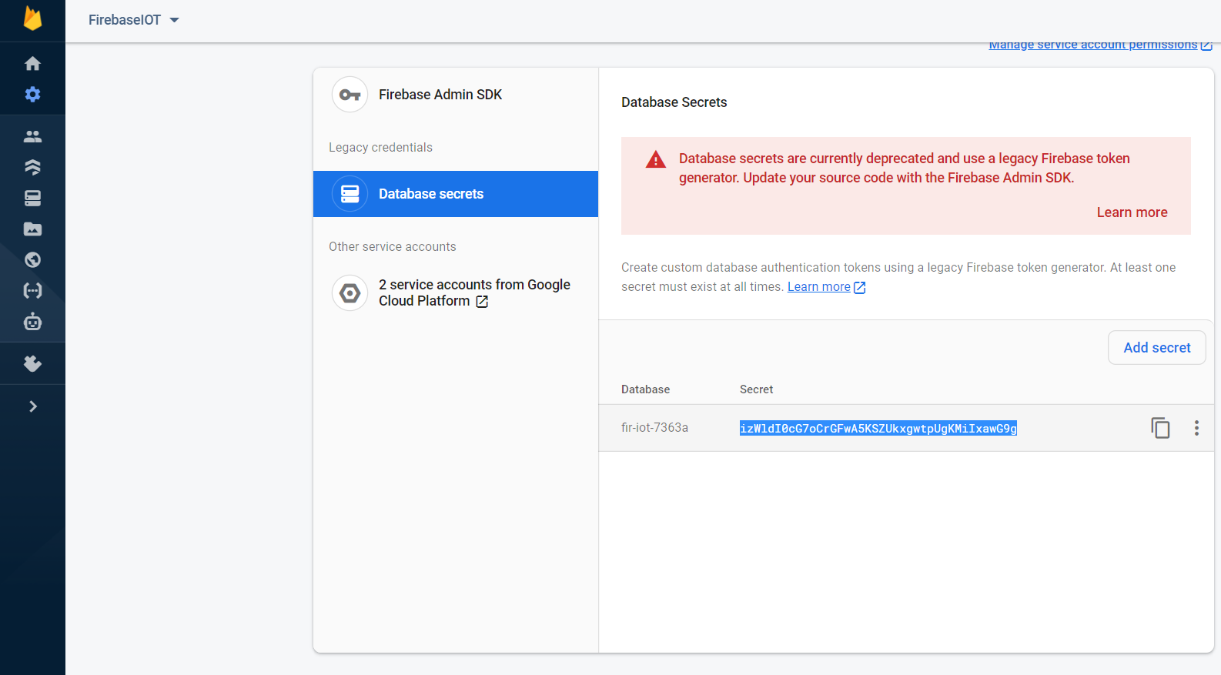
Implementation
HARDWARE AND SOFTWARE INTEGERATION
After completing the implementation of hardware and software we integrate both of it, as follows:
CONNECTING FIREBASE WITH MIT APP INVENTOR
Fig1: Firebase: copying the firebase token
Step 1: from the above fig1 Go to firebase, open the settings then select project settings, go to service accounts where u can see database secrets select it and copy the token.

Slide 17
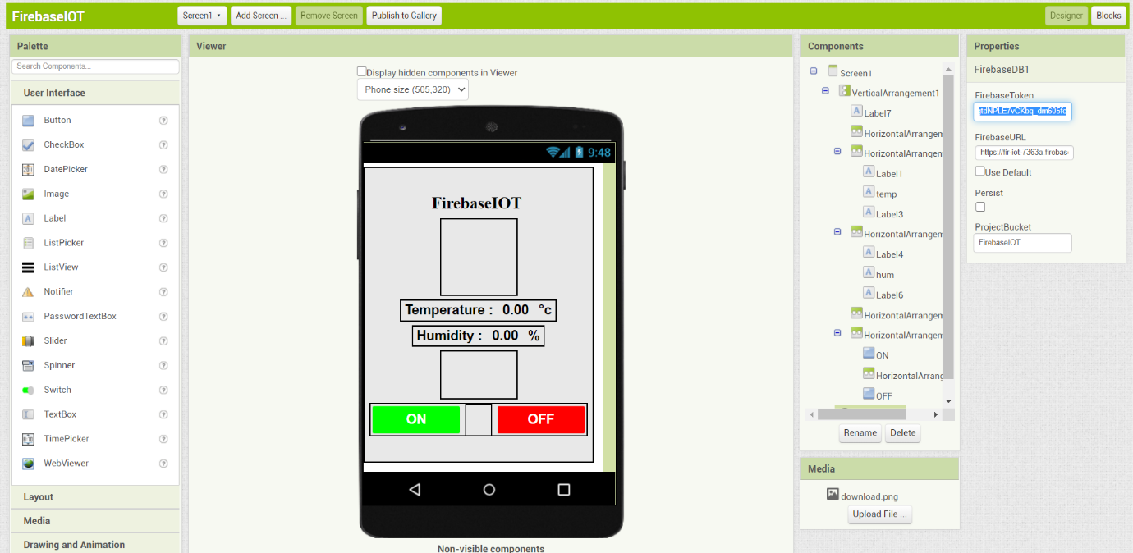
Fig 2 MIT App inventor: paste the token copied from firebase.
Step 2: from the above fig2 now open the MIT app inventor, select the database where you can find firebase token in properties, paste the token copied from the firebase.

Slide 18
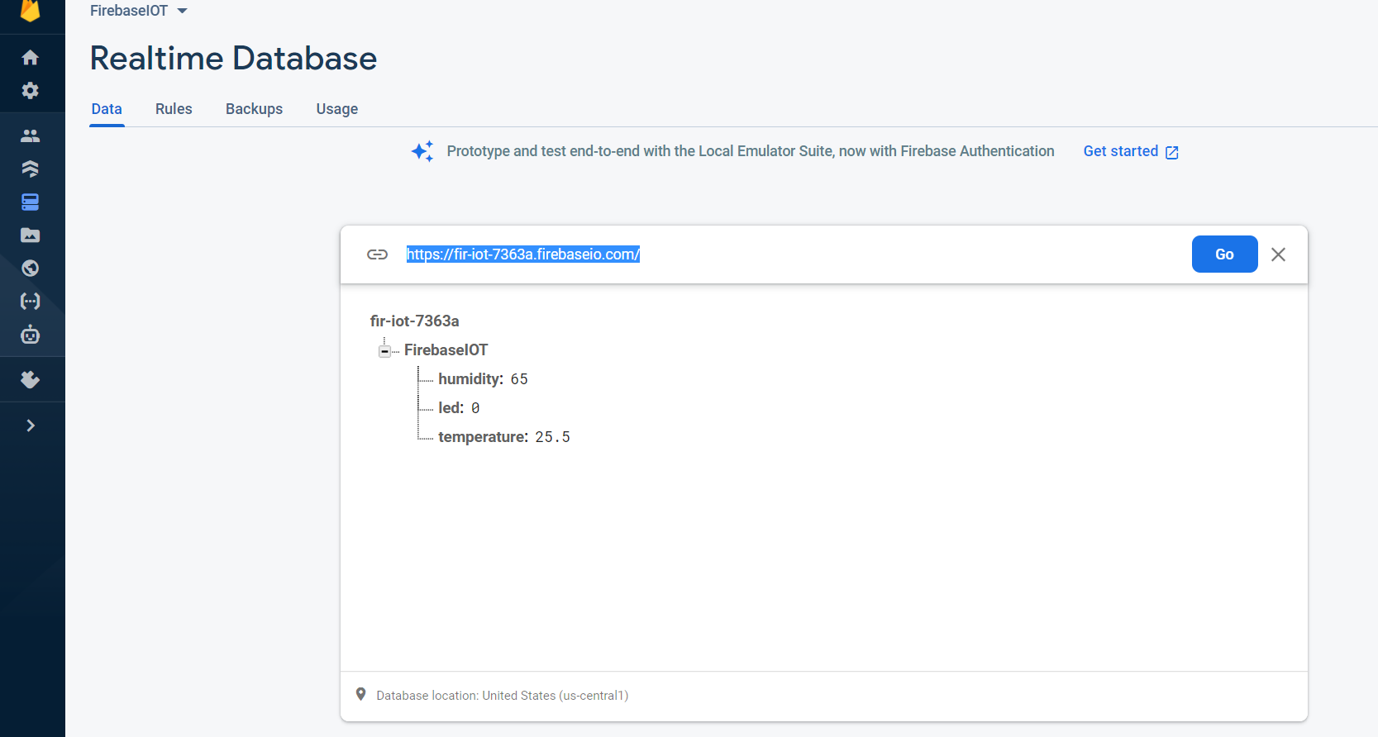
Fig 3 Firebase: go to Realtime database to copy the URL.
Step3:from the above fig3 from Realtime database copy the URL, to paste it to MIT App inventor.

Slide 19
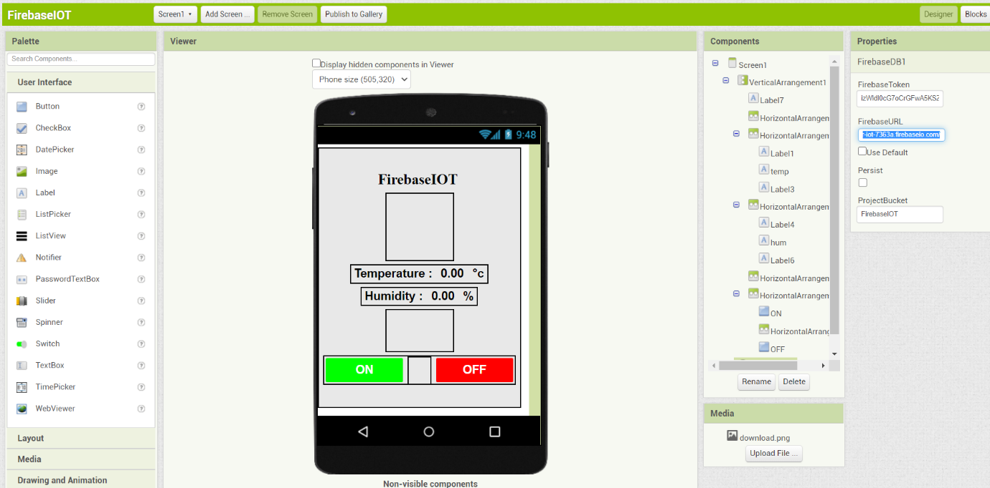
Fig 4 MIT App inventor: paste the URL.
Step4: from above fig4 after copying the URL from firebase we must paste the URL in MIT app inventor, go to properties paste the URL on firebase URL.
This is how we connect firebase to MIT App inventor.

Slide 20
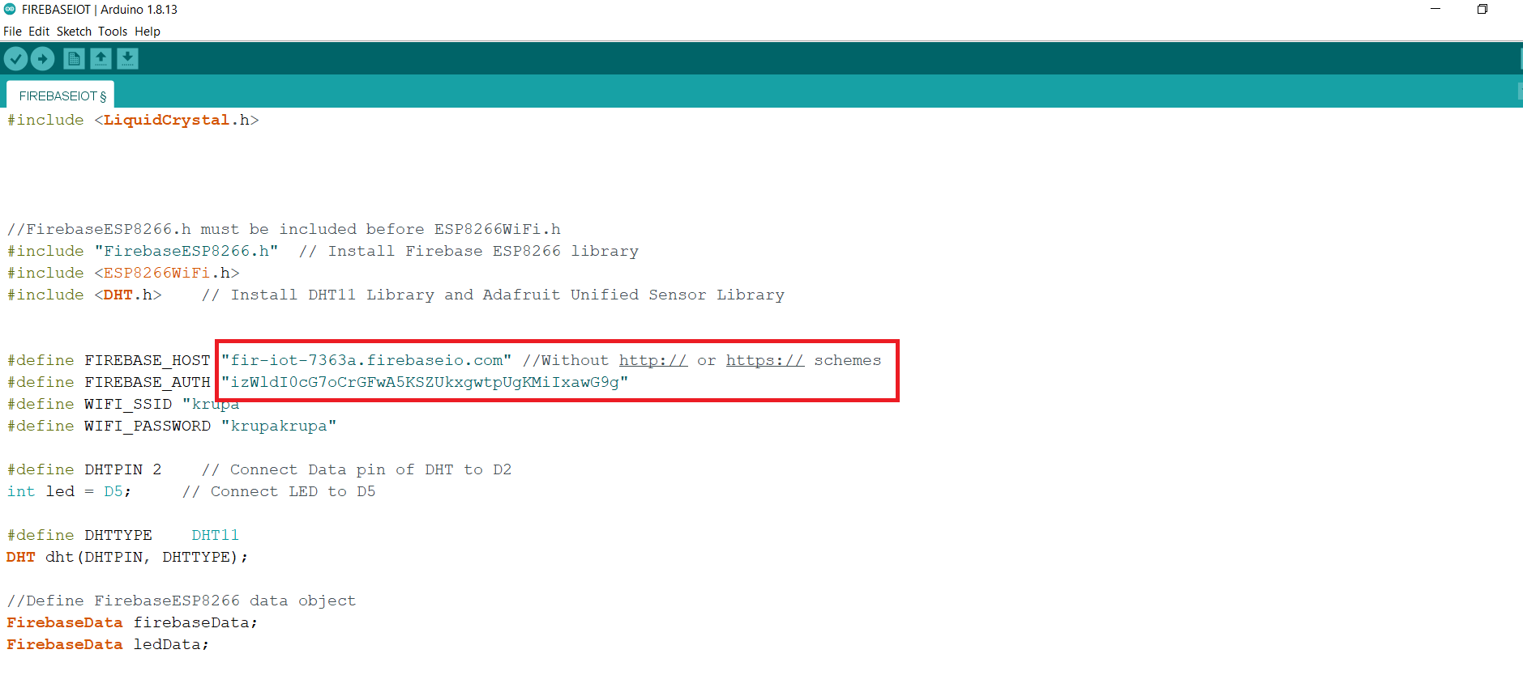
CONNECTING FIREBASE TO ARDUINO
Step 1: first copy the token and URL from the firebase, as show above.
Fig 5 Arduino: pasting URL and token in code.
Step 2: paste the URL and token in the code, where URL to firebase_host and token to firebase_AUTH as shown in the above fig. this completes the connection between firebase and Arduino.
Step 3: type your wifi_ssid and password in code, where ssid to wifi_ssid and password to wifi_password.

Slide 21
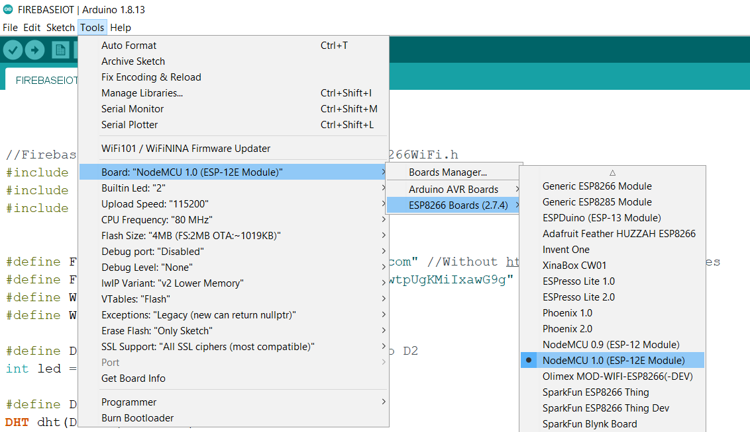
Fig 6 Selection of board.
Step 4: next step is to select board from tools, once we finish typing the code save it and then select tools where we have to select board, then select ESP8266 Board (2.7.4) wherein we find NodeMCU(ESP-12E Module) select it.

Slide 22
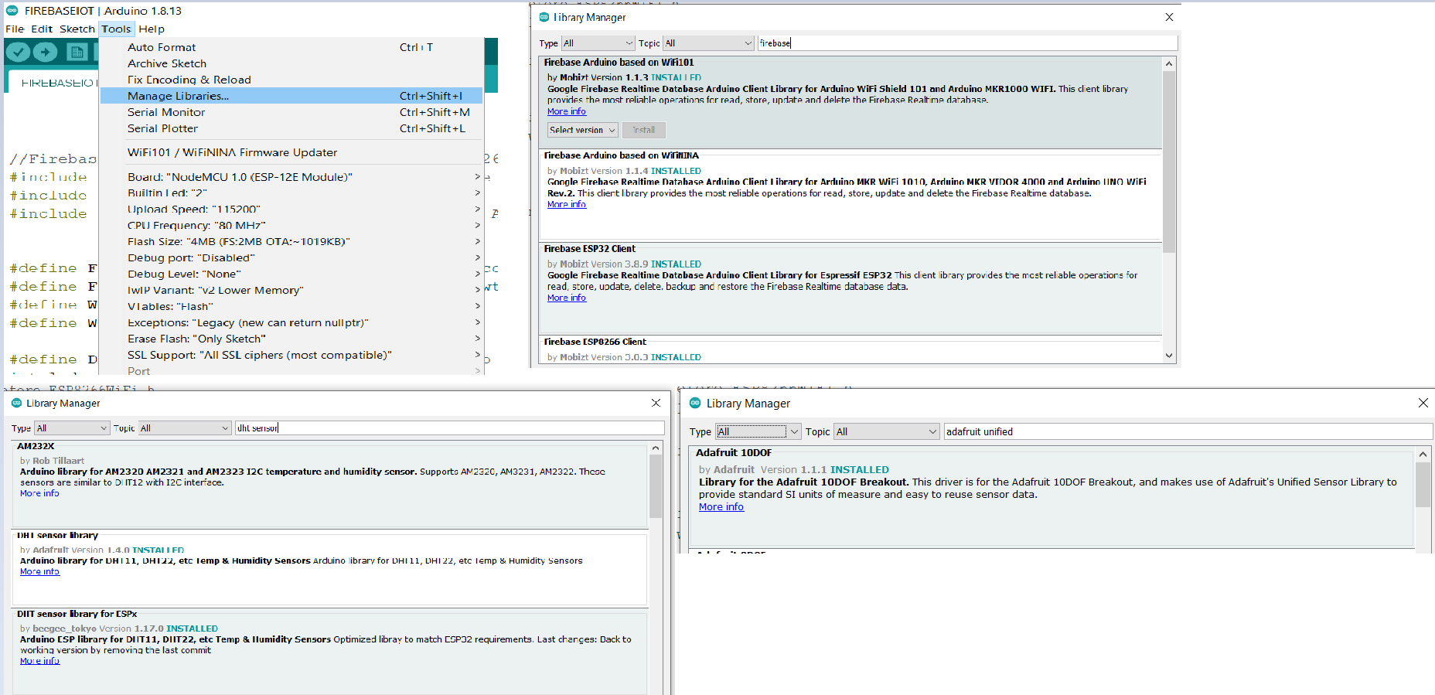
Fig 7 Adding libraires.
Step 5: after selection of board, lets add libraries, again go to tools where we can find manage libraries select it, after which u get a page where we have to install the following libraries:
Firebase ESP8266 Library
DHT Sensor Library
Adafruit Unified Sensor Library

Slide 23
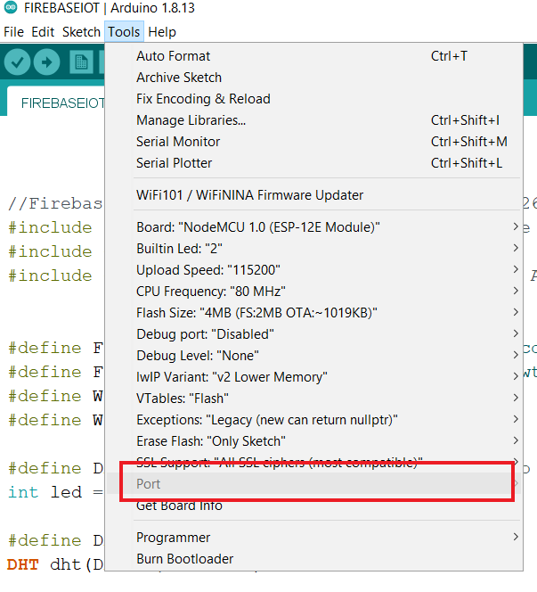
Fig 8 Selection of port.
Step 6: after installation of required libraires select port, now again go to tools select the port and we will find options over there as comb3, comb5... etc. select one of those.

Slide 24
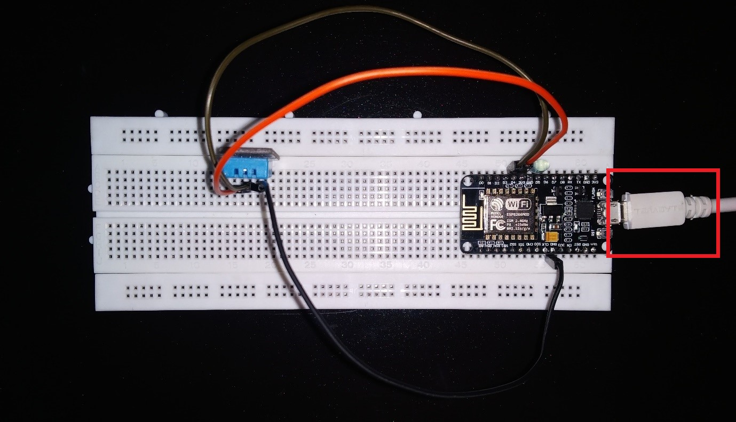
CONNECTION OF ARDUINO IDE AND HARDWARE
Fig 9 Hardware circuit.
As we can see USB cable in the above figure, this cable connects the Arduino IDE to hardware, where one end of USB cable is connected to PC and the other end to NodeMCU.

Slide 25
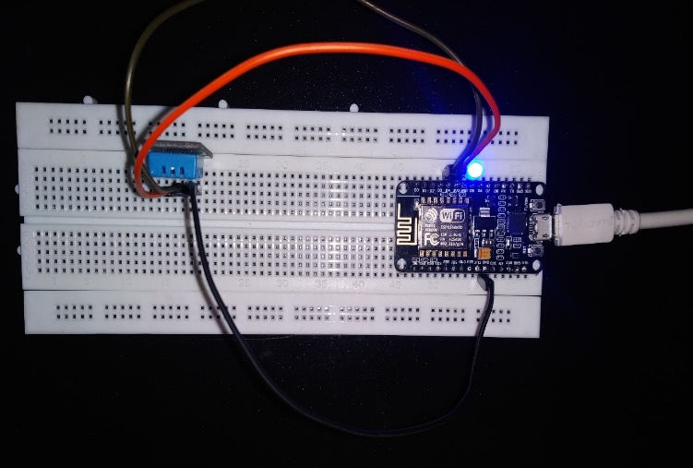
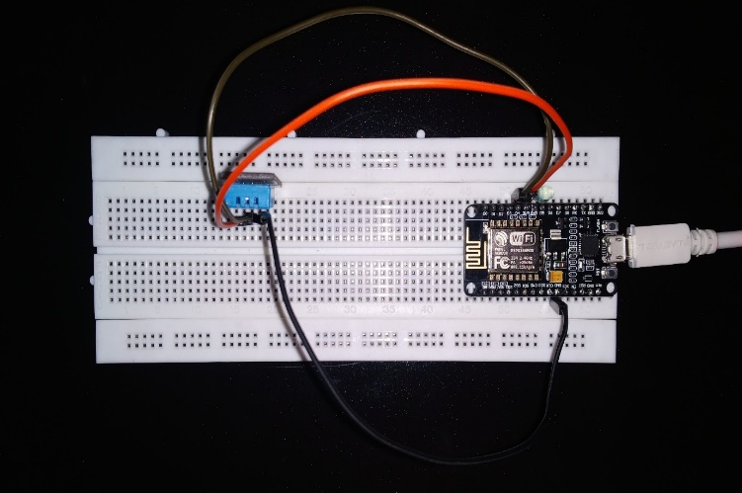
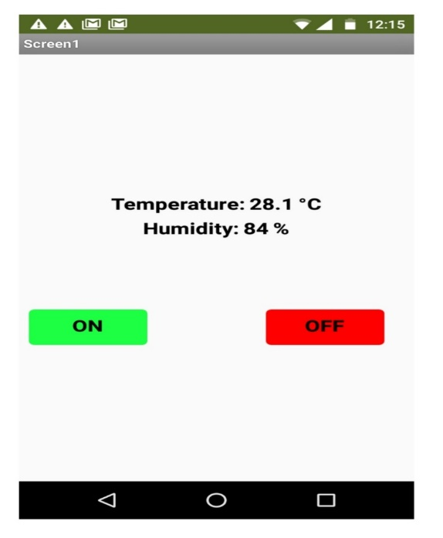
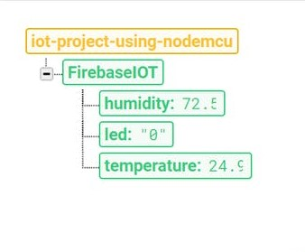
Snapshots
FINAL OUTPUT WITH LED_ON FINAL OUTPUT WITH LED_OFF
OUTPUT ON ANDROID MOBILE APPLICATION
OUTPUT ON REALTIME DATABASE - FIREBASE
Fig 6.4 : OUTPUT ON REALTIME DATABASE - FIREBASE

Slide 26
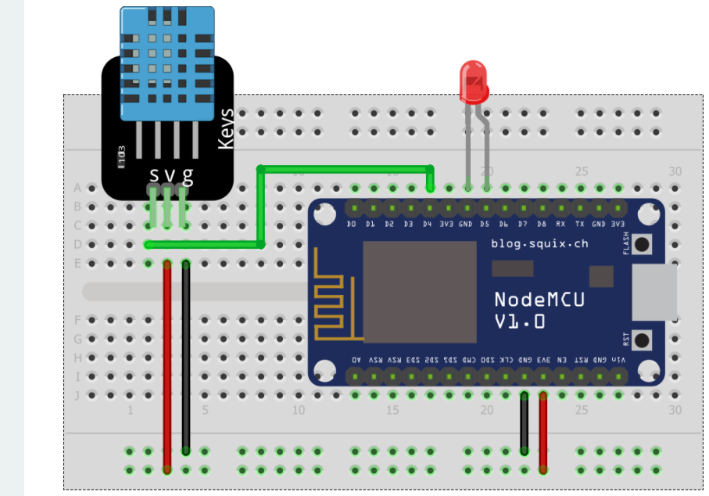
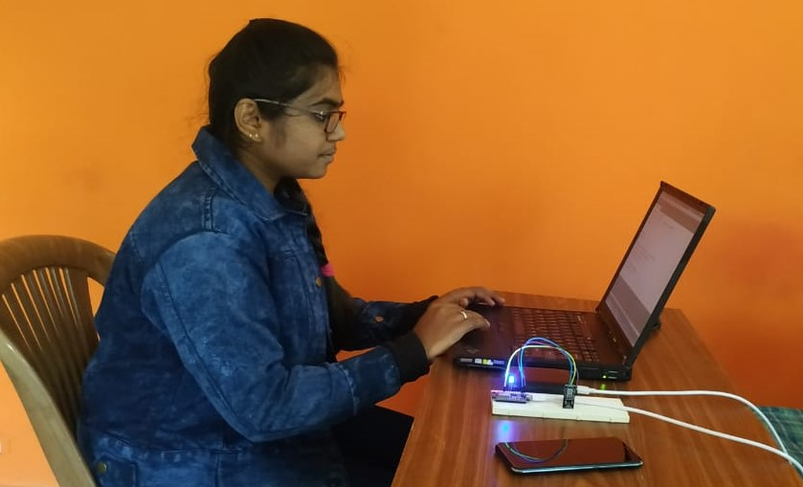
CIRCUIT DIAGRAM
SNAPSHOT OF WORKING AT INTERNSHIP
Fig 6.6 : SNAPSHOT OF WORKING AT INTERNSHIP
Fig 6.4 : OUTPUT ON REALTIME DATABASE - FIREBASE

Slide 27
references
https://firebase.google.com/ - For Learning Basics Of Firebase And Creating Realtime Databse.
https://appinventor.mit.edu/ - To Create Android Mobile Application For The System.
https://www.netacad.com/courses/packet-tracer - To Learn The Basics Of Cisco Packet Tracer.
http://www.ssttech.in/ - To Learn Iot Basics And Start Building Working Models Based On Iot.
https://www.omnisci.com/technical-glossary/embedded-systems - To Learn Embedded Systems And Its Basics Workings.

Slide 28
Thank you

